Slide 1
Fourier Series Generating Functions

Slide 2
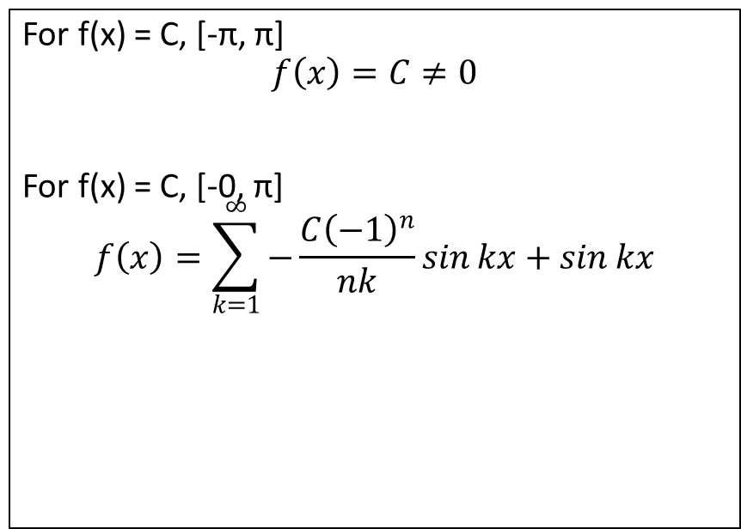
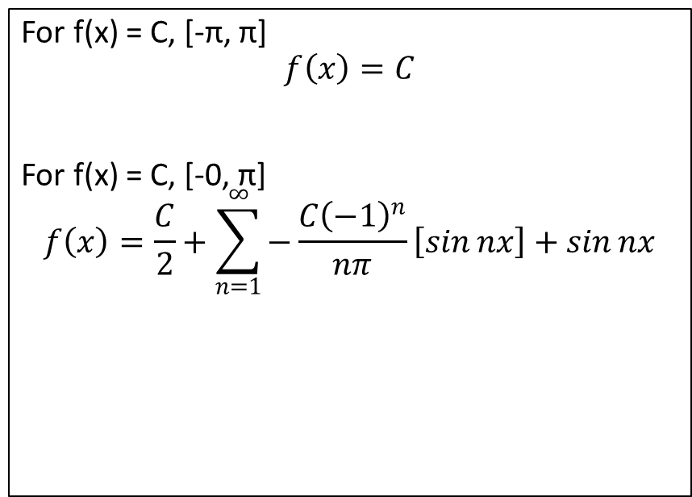
f(x) = C
Classical Formula
Lanczos Formula
For f(x) = C, [-π, π]
$$f\left(x\right)=C$$
For f(x) = C, [-0, π]
$$f\left(x\right)=\frac{C}{2}+\sum_{n=1}^{∞}{−\frac{C{\left(−1\right)}^{n}}{nπ}\left[\sin{nx}\right]+\sin{nx}}$$
For f(x) = C, [-π, π]
$$f\left(x\right)=C≠0$$
For f(x) = C, [-0, π]
$$f\left(x\right)=\sum_{k=1}^{∞}{−\frac{C{\left(−1\right)}^{n}}{nk}\sin{kx}+\sin{kx}}$$

Slide 3
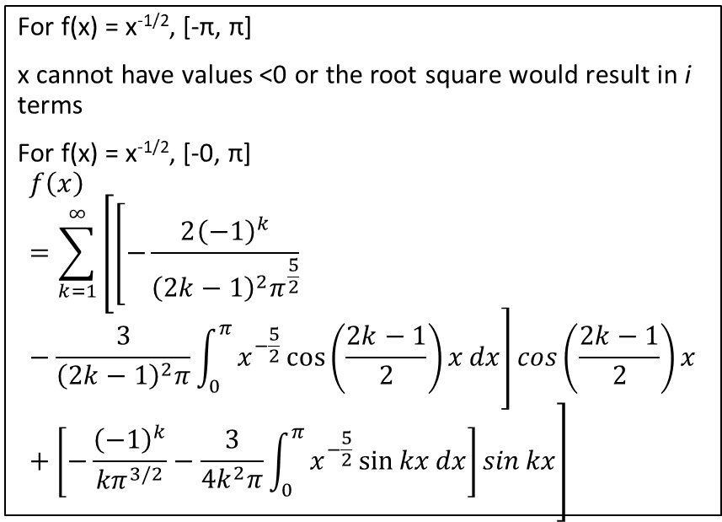
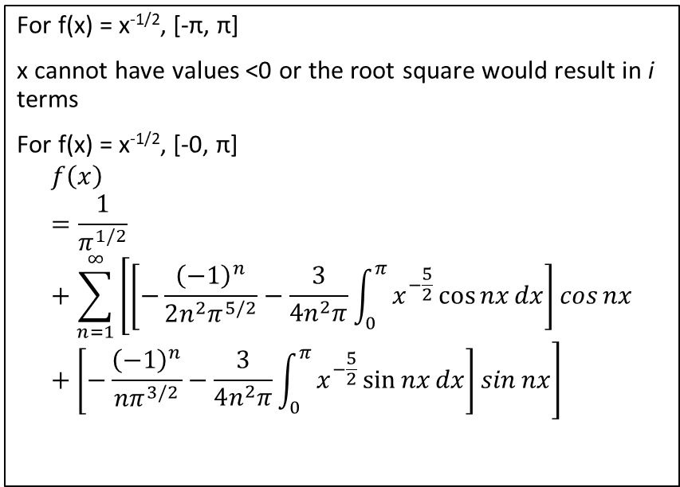
f(x) = x^{-1/2}
Classical Formula
Lanczos Formula
For f(x) = x^{-1/2}, [-π, π]
x cannot have values <0 or the root square would result in i terms
For f(x) = x^{-1/2}, [-0, π]
$$f\left(x\right)=\frac{1}{π^{1/2}}+\sum_{n=1}^{∞}{\left[\left[−\frac{{\left(−1\right)}^{n}}{2n^{2}π^{5/2}}−\frac{3}{4n^{2}π}\int_{0}^{π}{x^{−\frac{5}{2}}\cos{nx}dx}\right]\cos{nx}+\left[−\frac{{\left(−1\right)}^{n}}{{nπ}^{3/2}}−\frac{3}{4n^{2}π}\int_{0}^{π}{x^{−\frac{5}{2}}\sin{nx}dx}\right]\sin{nx}\right]}$$
For f(x) = x^{-1/2}, [-π, π]
x cannot have values <0 or the root square would result in i terms
For f(x) = x^{-1/2}, [-0, π]
$$f\left(x\right)=\sum_{k=1}^{∞}{\left[\left[−\frac{2{\left(−1\right)}^{k}}{{\left(2k−1\right)}^{2}π^{\frac{5}{2}}}−\frac{3}{{\left(2k−1\right)}^{2}π}\int_{0}^{π}{x^{−\frac{5}{2}}\cos\left(\frac{2k−1}{2}\right)xdx}\right]\cos\left(\frac{2k−1}{2}\right)x+\left[−\frac{{\left(−1\right)}^{k}}{{kπ}^{3/2}}−\frac{3}{4k^{2}π}\int_{0}^{π}{x^{−\frac{5}{2}}\sin{kx}dx}\right]\sin{kx}\right]}$$

Slide 4
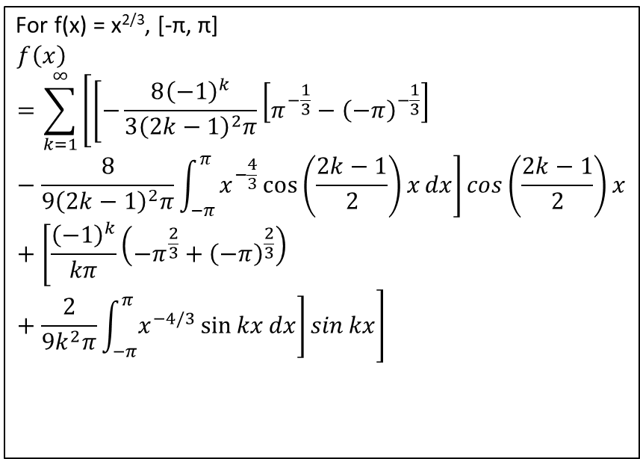
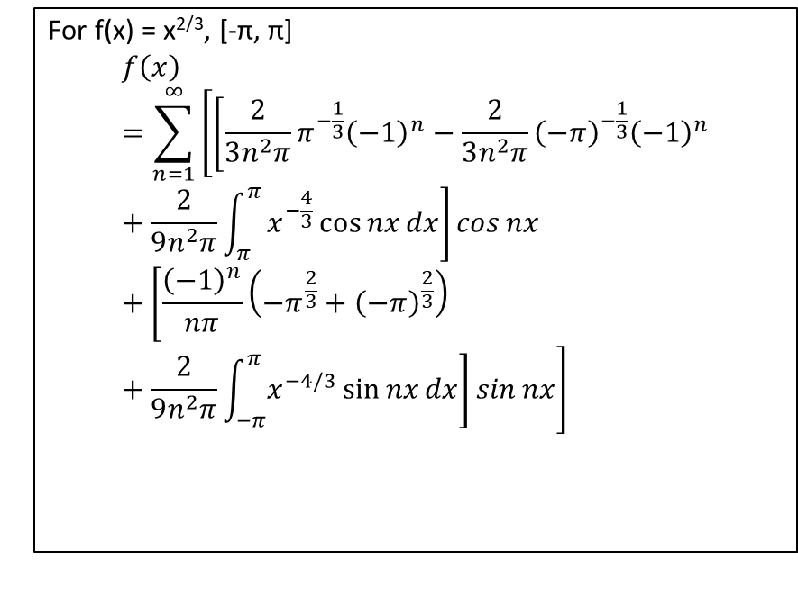
f(x) = x^{2/3}
Classical Formula
Lanczos Formula
For f(x) = x^{2/3}, [-π, π]
$$f\left(x\right)=\sum_{n=1}^{∞}{\left[\left[\frac{2}{3n^{2}π}π^{−\frac{1}{3}}{\left(−1\right)}^{n}−\frac{2}{3n^{2}π}{\left(−π\right)}^{−\frac{1}{3}}{\left(−1\right)}^{n}+\frac{2}{9n^{2}π}\int_{π}^{π}{x^{−\frac{4}{3}}\cos{nx}dx}\right]\cos{nx}+\left[\frac{{\left(−1\right)}^{n}}{nπ}\left(−π^{\frac{2}{3}}+{\left(−π\right)}^{\frac{2}{3}}\right)+\frac{2}{9n^{2}π}\int_{−π}^{π}{x^{−4/3}\sin{nx}dx}\right]\sin{nx}\right]}$$
For f(x) = x^{2/3}, [-π, π]
$$f\left(x\right)=\sum_{k=1}^{∞}{\left[\left[−\frac{8{\left(−1\right)}^{k}}{{3\left(2k−1\right)}^{2}π}\left[π^{−\frac{1}{3}}−{\left(−π\right)}^{−\frac{1}{3}}\right]−\frac{8}{9{\left(2k−1\right)}^{2}π}\int_{−π}^{π}{x^{−\frac{4}{3}}\cos\left(\frac{2k−1}{2}\right)xdx}\right]\cos\left(\frac{2k−1}{2}\right)x+\left[\frac{{\left(−1\right)}^{k}}{kπ}\left(−π^{\frac{2}{3}}+{\left(−π\right)}^{\frac{2}{3}}\right)+\frac{2}{9k^{2}π}\int_{−π}^{π}{x^{−4/3}\sin{kx}dx}\right]\sin{kx}\right]}$$

Slide 5
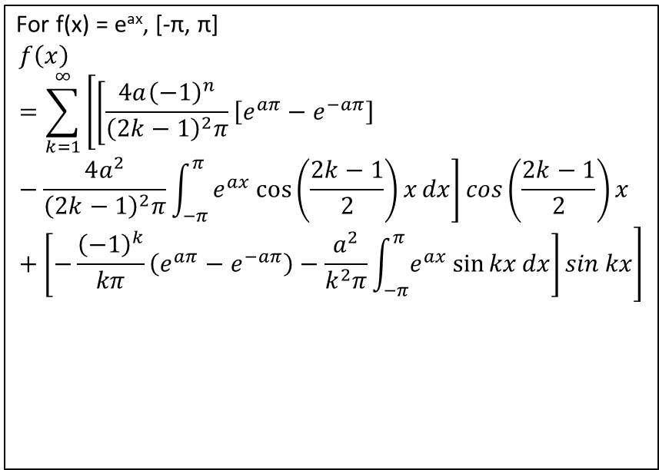
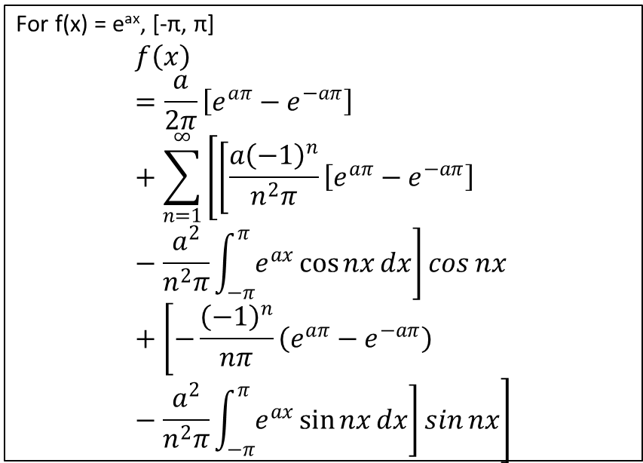
f(x) = e^{ax}
Classical Formula
Lanczos Formula
For f(x) = e^{ax}, [-π, π]
$$f\left(x\right)=\frac{a}{2π}\left[e^{aπ}−e^{−aπ}\right]+\sum_{n=1}^{∞}{\left[\left[\frac{{a\left(−1\right)}^{n}}{n^{2}π}\left[e^{aπ}−e^{−aπ}\right]−\frac{a^{2}}{n^{2}π}\int_{−π}^{π}{e^{ax}\cos{nx}dx}\right]\cos{nx}+\left[−\frac{{\left(−1\right)}^{n}}{nπ}\left(e^{aπ}−e^{−aπ}\right)−\frac{a^{2}}{n^{2}π}\int_{−π}^{π}{e^{ax}\sin{nx}dx}\right]\sin{nx}\right]}$$
For f(x) = e^{ax}, [-π, π]
$$f\left(x\right)=\sum_{k=1}^{∞}{\left[\left[\frac{4a{\left(−1\right)}^{n}}{{\left(2k−1\right)}^{2}π}\left[e^{aπ}−e^{−aπ}\right]−\frac{4a^{2}}{{\left(2k−1\right)}^{2}π}\int_{−π}^{π}{e^{ax}\cos\left(\frac{2k−1}{2}\right)xdx}\right]\cos\left(\frac{2k−1}{2}\right)x+\left[−\frac{{\left(−1\right)}^{k}}{kπ}\left(e^{aπ}−e^{−aπ}\right)−\frac{a^{2}}{k^{2}π}\int_{−π}^{π}{e^{ax}\sin{kx}dx}\right]\sin{kx}\right]}$$

Slide 6
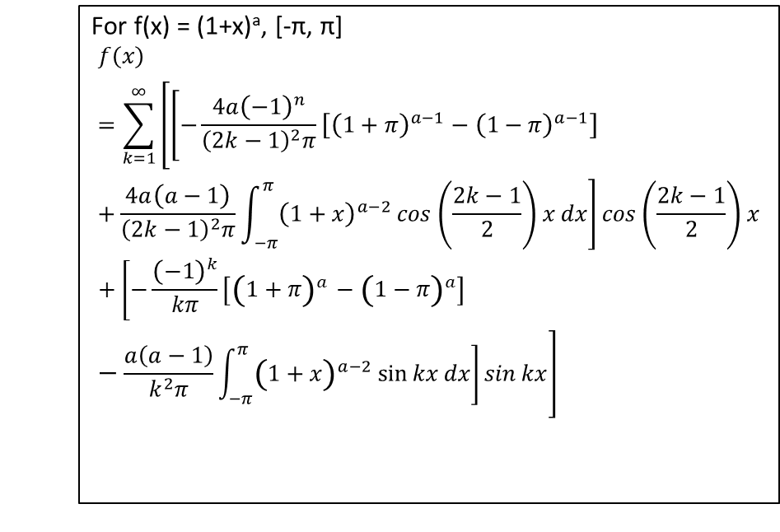
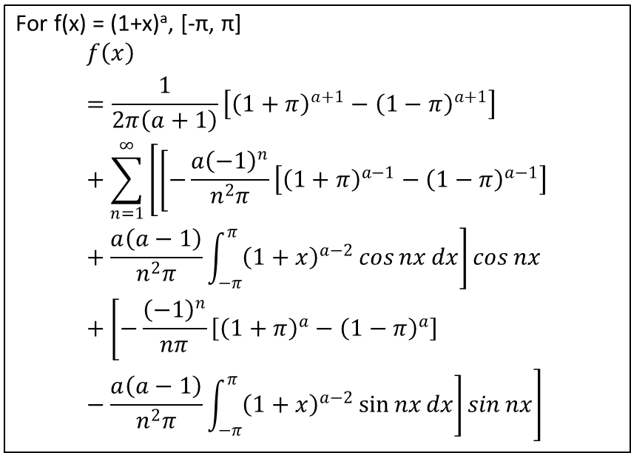
f(x) = (1+x)ª
Classical Formula
Lanczos Formula
For f(x) = (1+x)ª, [-π, π]
$$f\left(x\right)=\frac{1}{2π\left(a+1\right)}\left[{\left(1+π\right)}^{a+1}−{\left(1−π\right)}^{a+1}\right]+\sum_{n=1}^{∞}{\left[\left[−\frac{{a\left(−1\right)}^{n}}{n^{2}π}\left[{\left(1+π\right)}^{a−1}−{\left(1−π\right)}^{a−1}\right]+\frac{a\left(a−1\right)}{n^{2}π}\int_{−π}^{π}{{\left(1+x\right)}^{a−2}\cos{nx}dx}\right]\cos{nx}+\left[−\frac{{\left(−1\right)}^{n}}{nπ}\left[{\left(1+π\right)}^{a}−{\left(1−π\right)}^{a}\right]−\frac{a\left(a−1\right)}{n^{2}π}\int_{−π}^{π}{{\left(1+x\right)}^{a−2}\sin{nx}dx}\right]\sin{nx}\right]}$$
For f(x) = (1+x)ª, [-π, π]
$$f\left(x\right)=\sum_{k=1}^{∞}{\left[\left[−\frac{4a{\left(−1\right)}^{n}}{{\left(2k−1\right)}^{2}π}\left[{\left(1+π\right)}^{a−1}−{\left(1−π\right)}^{a−1}\right]+\frac{4a\left(a−1\right)}{{\left(2k−1\right)}^{2}π}\int_{−π}^{π}{{\left(1+x\right)}^{a−2}\cos\left(\frac{2k−1}{2}\right)xdx}\right]\cos\left(\frac{2k−1}{2}\right)x+\left[−\frac{{\left(−1\right)}^{k}}{kπ}\left[{\left(1+π\right)}^{a}−{\left(1−π\right)}^{a}\right]−\frac{a\left(a−1\right)}{k^{2}π}\int_{−π}^{π}{{\left(1+x\right)}^{a−2}\sin{kx}dx}\right]\sin{kx}\right]}$$

Slide 7
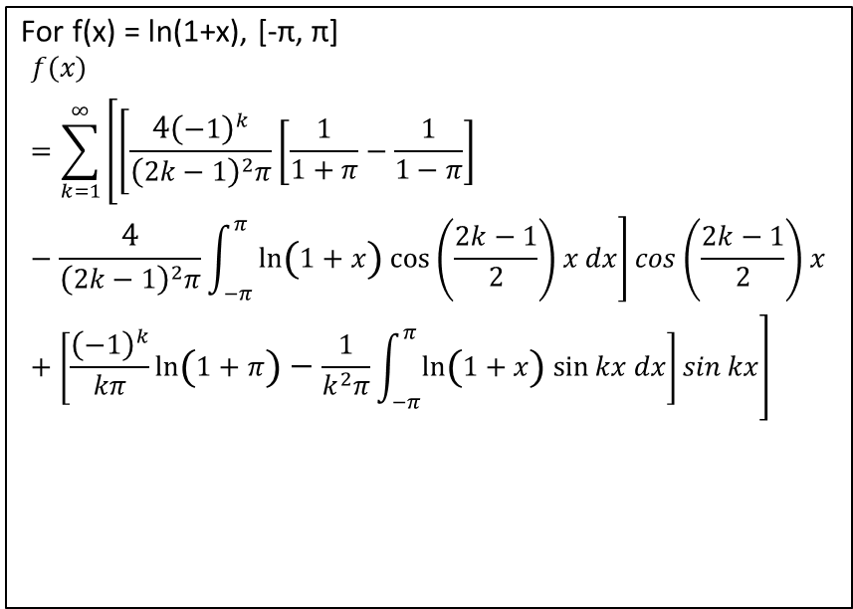
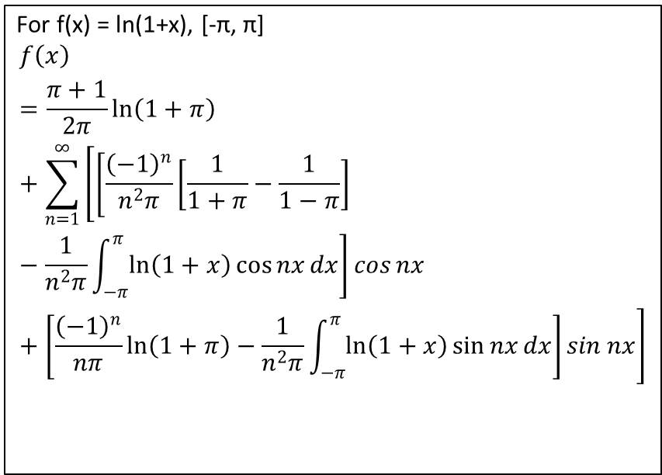
f(x) = ln(1+x)
Classical Formula
Lanczos Formula
For f(x) = ln(1+x), [-π, π]
$$f\left(x\right)=\frac{π+1}{2π}\ln\left(1+π\right)+\sum_{n=1}^{∞}{\left[\left[\frac{{\left(−1\right)}^{n}}{n^{2}π}\left[\frac{1}{1+π}−\frac{1}{1−π}\right]−\frac{1}{n^{2}π}\int_{−π}^{π}{\ln\left(1+x\right)\cos{nx}dx}\right]\cos{nx}+\left[\frac{{\left(−1\right)}^{n}}{nπ}\ln\left(1+π\right)−\frac{1}{n^{2}π}\int_{−π}^{π}{\ln\left(1+x\right)\sin{nx}dx}\right]\sin{nx}\right]}$$
For f(x) = ln(1+x), [-π, π]
$$f\left(x\right)=\sum_{k=1}^{∞}{\left[\left[\frac{4{\left(−1\right)}^{k}}{{\left(2k−1\right)}^{2}π}\left[\frac{1}{1+π}−\frac{1}{1−π}\right]−\frac{4}{{\left(2k−1\right)}^{2}π}\int_{−π}^{π}{\ln\left(1+x\right)\cos\left(\frac{2k−1}{2}\right)xdx}\right]\cos\left(\frac{2k−1}{2}\right)x+\left[\frac{{\left(−1\right)}^{k}}{kπ}\ln\left(1+π\right)−\frac{1}{k^{2}π}\int_{−π}^{π}{\ln\left(1+x\right)\sin{kx}dx}\right]\sin{kx}\right]}$$

